Slide 1
Investigating the losses of Insurance Renewal
Team members:
1.Shanmuga Dhivya.S [711715104054]
2.Vineetha.S [711715104073]
3.Yuvaraj.G [711715104076]
Guided By:
Industry Mentor:Ms.V.Yukthika
Faculty Guide:Ms.M.Shanthini
Department of CSE, KGiSL Institute of Technology, Coimbatore

Slide 2
Abstract
General Insurance policies are renewed annually.The insurance company usually alerts the policyholder to renew the policy near the end of its term.The main objective of our project is to investigate the loss of insurance renewal caused by certain criterias like accidental cases, blacklisting (policy holder, vehicle,engine/chassis), insurance cancelation,theft etc..
Department of CSE, KGiSL Institute of Technology, Coimbatore

Slide 3
Area Introduction-Existing system
In the existing system, data analysis for renewal loss was partially determined through excel worksheets and the report was generated. The current system makes all possibilities by categorising the drawbacks of renewal loss, such as theft of vehicle, policy cancellation, blacklisting etc.
Department of CSE, KGiSL Institute of Technology, Coimbatore

Slide 4
Proposed System
In order to overcome the demerits of the existing system, we have done data analysis by accessing some large datasets using tableau
Advantages over existing methods
Working with big data.
Fast transmit in Data
Future Enhancements
We can track the client who are pending with premium without renewing the policies.
Predictive analysis can be made for future cases.
Department of CSE, KGiSL Institute of Technology, Coimbatore

Slide 5
Strategy
1. Subsequent claiming from policy holders (more accidental cases).
2.Policy cancellation due to neglegance.
3. Blacklist of Policy holders & Vehicle, engine /chassis, incase of Motor policies.
4.Theft & fraudulent cases.

Slide 6
ER Diagram
Renewal date
Cancellation details
Policy Effective date
Policy No
name
Policy Type
.
Policy Holder / Insured
owns
Insurance Policy
Check for Renewal
Policy cancellation
Blacklist details
Renewed on time
Theft / Fraud cases

Slide 7
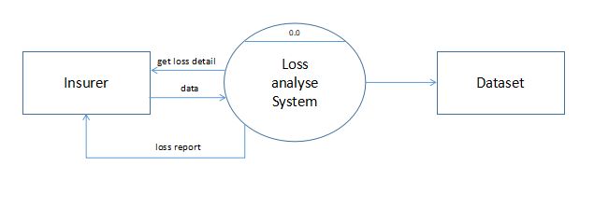
Data flow Diagram
Level 0

Slide 8
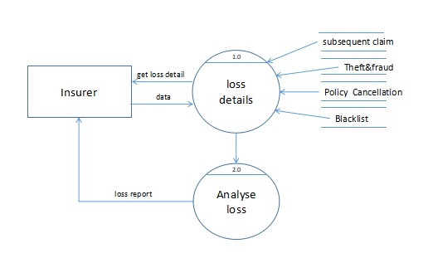
Level 1

Slide 9
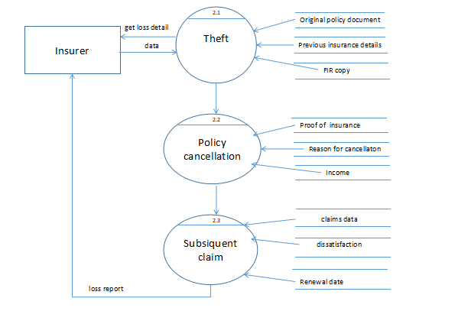
Level 2

Slide 10
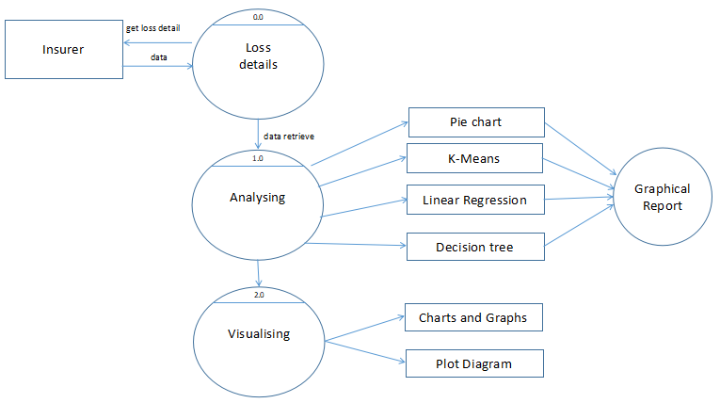
Level 3

Slide 11
Module Splitup
MODULE 1
Data extraction & cleaning
MODULE 2
Analysing the data of unpaid premiums.
MODULE 3
Data Manipulation and predictions of linear regression.
MODULE 4
Generating the report for renewal losses.
Department of CSE, KGiSL Institute of Technology, Coimbatore

Slide 12
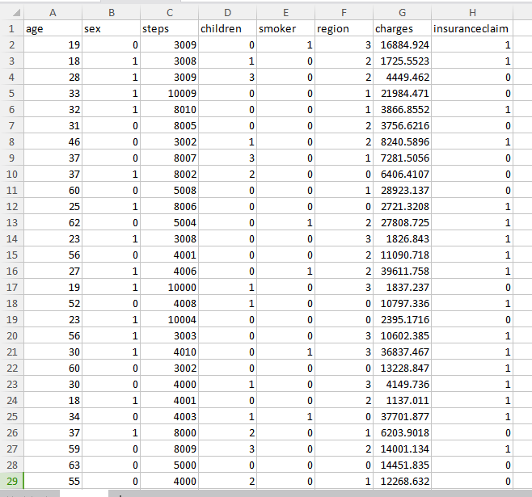
Module 1-For strategy #1- Subsequent claiming (Dataset)

Slide 13
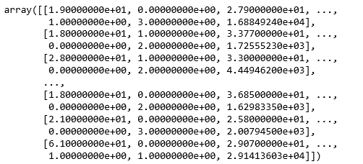
Data cleaning

Slide 14
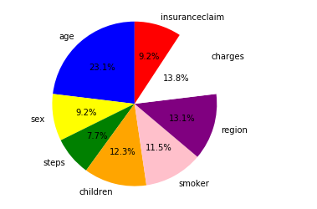
Pie-Chart

Slide 15
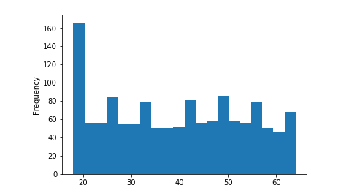
Data Visualization Type 1

Slide 16
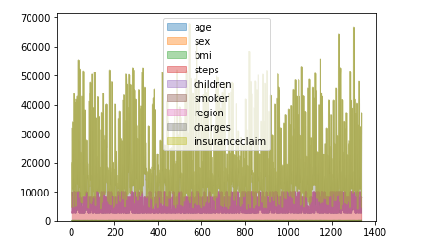
Type 2

Slide 17
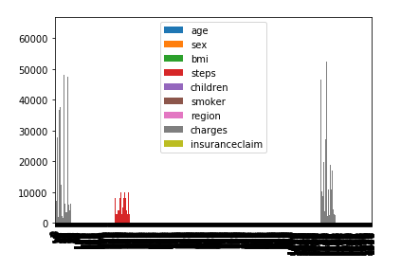
Type 3

Slide 18
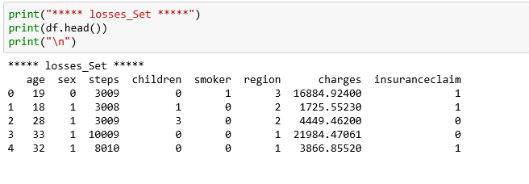
K-Means

Slide 19
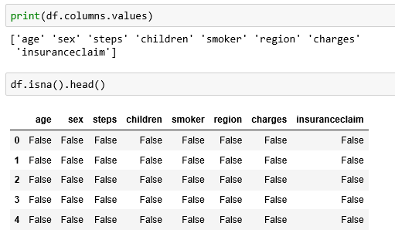

Slide 20
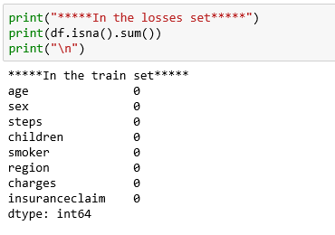

Slide 21
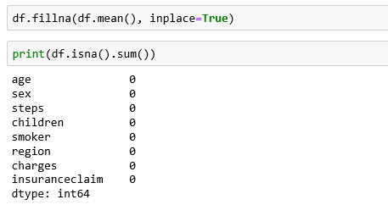

Slide 22
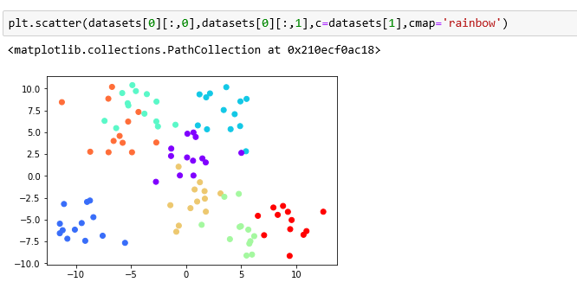

Slide 23
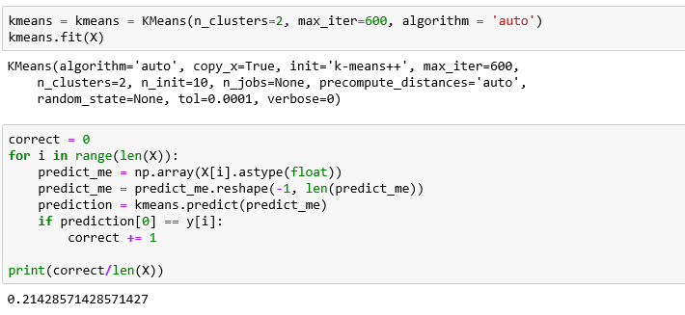

Slide 24
Software Requirements
Jupyter Notebook
Tableau
python Technology

Slide 25
Thank You

